Slide 1

Food Deserts in US in Association with Socioeconomic Factors and Related Health Conditions
FA21-IN-INFO-I501 Group 10
Team members: - Meghana Bibireddy, Rathnapriya Gopalakrishnan, Sri Rama Teja Makineedi, Patrick Page, Latha Sree Rayala, Sriha Yalamanchi

Slide 2
Introduction and Research Questions

Slide 3
Introduction
A food desert is an area of a community that lacks access to healthy, fresh food
More than 2 million people in the US live within a food desert
Food deserts are typically found in impoverished communities composed mainly of minorities
Food deserts may inhibit people from living healthy lives
Notes:
Mention our goal was to better understand the connections between food deserts and socioeconomic factors as well as to understand the devastating effects food deserts have on the overall health of the people that live in them.

Slide 4
Research Questions
Are food deserts more prevalent in counties that have higher populations of minorities?
Do food deserts result in higher percentages of people living with diabetes, high-cholesterol, obesity and cardiovascular diseases?
Does lacking a vehicle and living in a food desert increase risk of becoming unhealthy?
Do people that live in low-income and high poverty rate communities have a greater chance of living in a food desert?

Slide 5
Hypothesis

Slide 6
Hypothesis
Null hypothesis:
Food deserts are not more prevalent in areas that contain higher populations of minorities.
Food deserts do not contribute to increased percentages of diabetes, high-cholesterol, obesity or cardiovascular diseases.
Not having a vehicle and living in a food desert does not increase risk of becoming unhealthy.
People that live in low-income communities do not have a greater chance of living in a food desert.
Alternative hypothesis:
Food deserts are more prevalent in that contain higher populations of minorities.
Food deserts contribute to increased percentages of diabetes, high-cholesterol, obesity or cardiovascular diseases.
Not having a vehicle and living in a food desert increases risk of becoming unhealthy.
People that live in low-income communities have a greater chance of living in a food desert.

Slide 7
Data Collection

Slide 8
Data Sources
Health Data
Source: Center of Disease Control and Prevention
Tables: Obesity, Diabetes, High Cholesterol, Cardiovascular Disease Death Rate (2017-2019)
Food Desert Data
Source: U.S. DEPARTMENT OF AGRICULTURE Economic Research Service
Table: Food Access Research Atlas (2019)
Socio-Economic Data
Source: United States Census Bureau
Tables: Social and Economic Supplements, Educational Attainment (2020-2021)
SQL

Slide 9
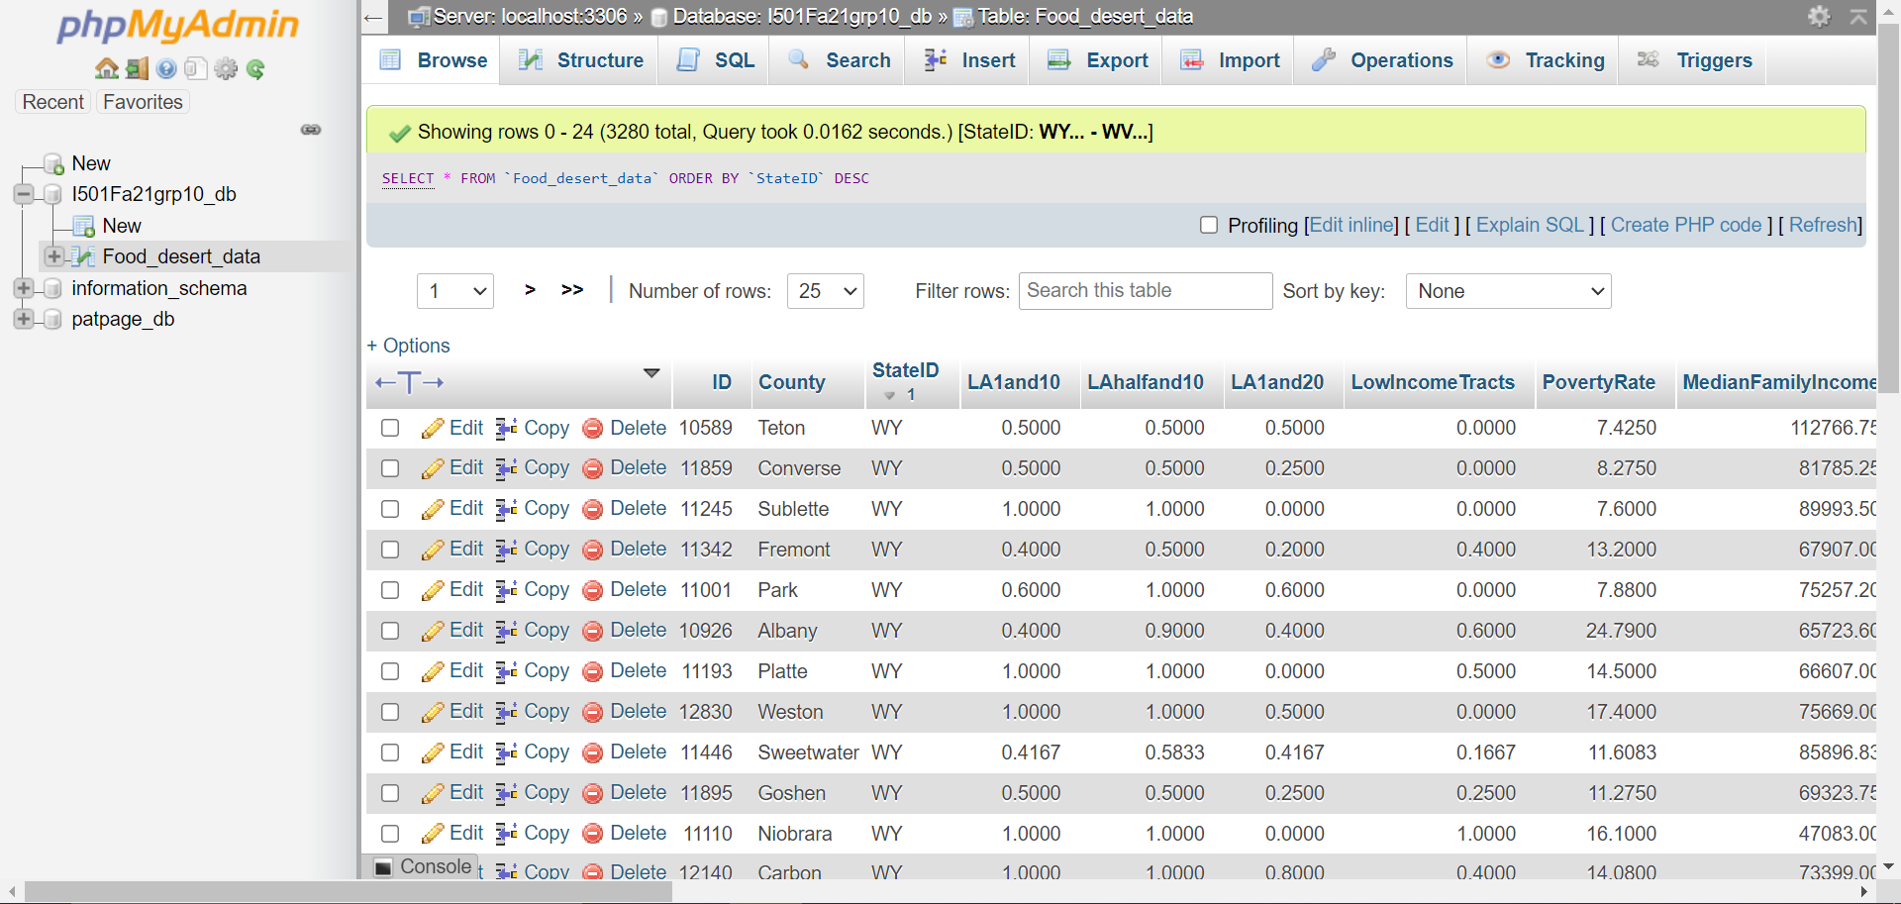

Slide 10
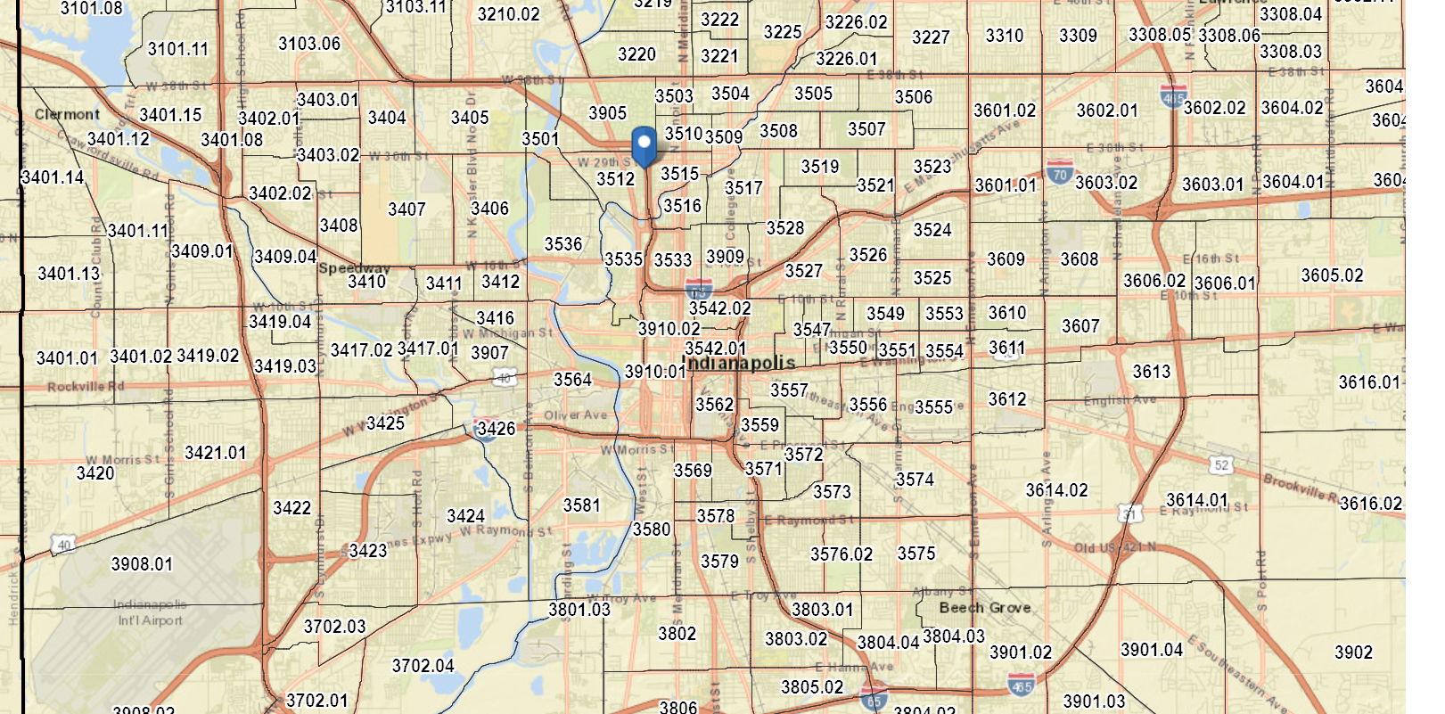
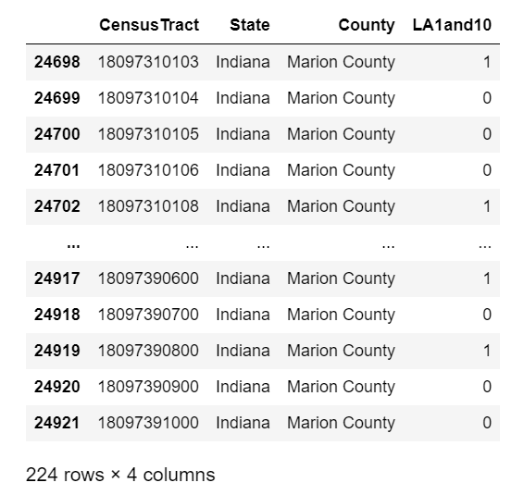
Importing Food Access Data

Slide 11
Data Cleaning

Slide 12
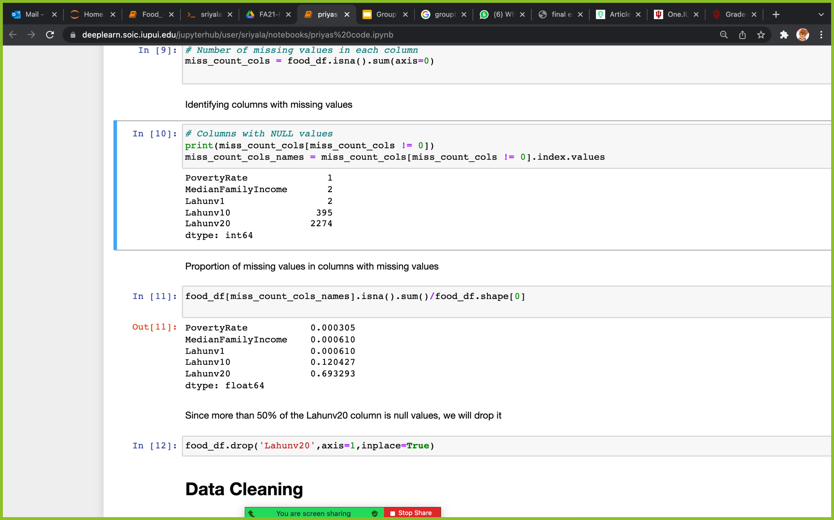
-The columns with null values are identified
-Columns that have more than 0.5(50%) of null values are identified
-Since Lahunv20 column have more than 50 % of null values, it is dropped from
food_df data frame.

Slide 13
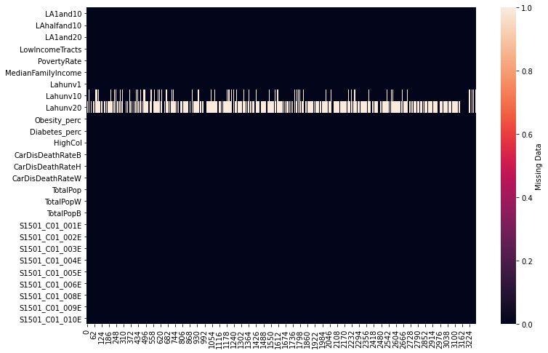
NULL VALUES
-Visualization of Null values in heatmap
-The highest number of missing values are concentrated in Lahunv1 and Lahunv20 columns

Slide 14
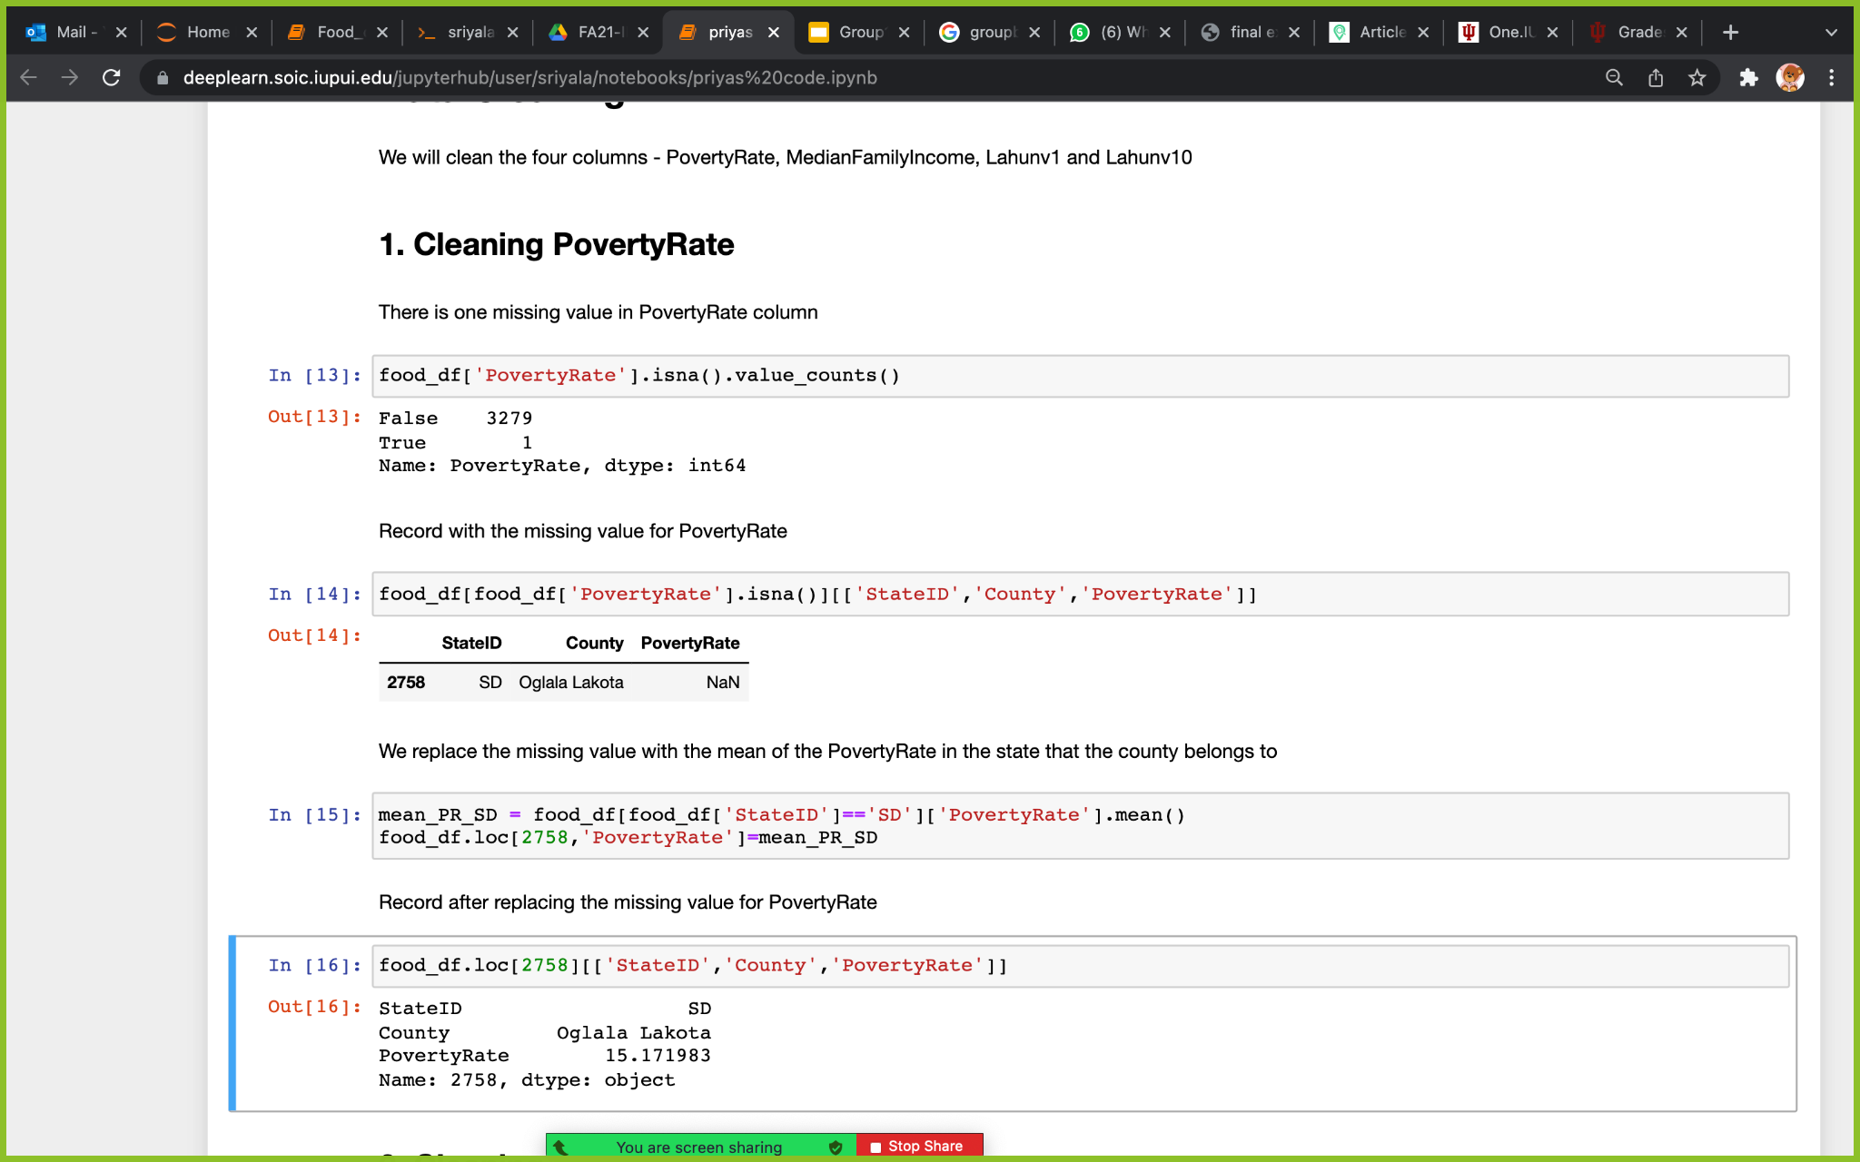
-Null value in the Povertyrate column is replaced with the mean of the poverty rate in the state (SD) that the county (Oglala Lakota) belongs to.
-Similarly we replaced the null values by taking the mean values of that particular column(Lahunv1, Lahunv10, MedianFamilyIncome) in the state that the county belongs to.

Slide 15
Data Visualization

Slide 16
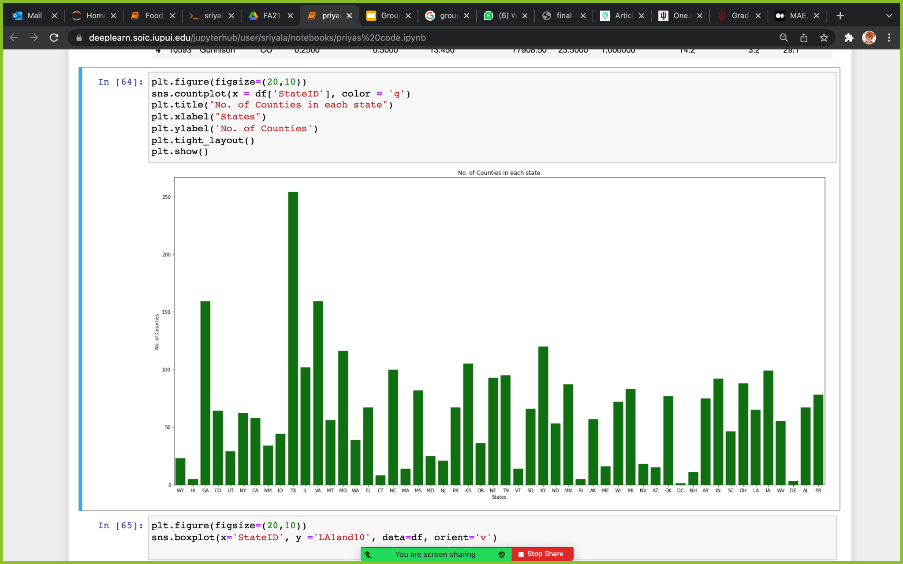
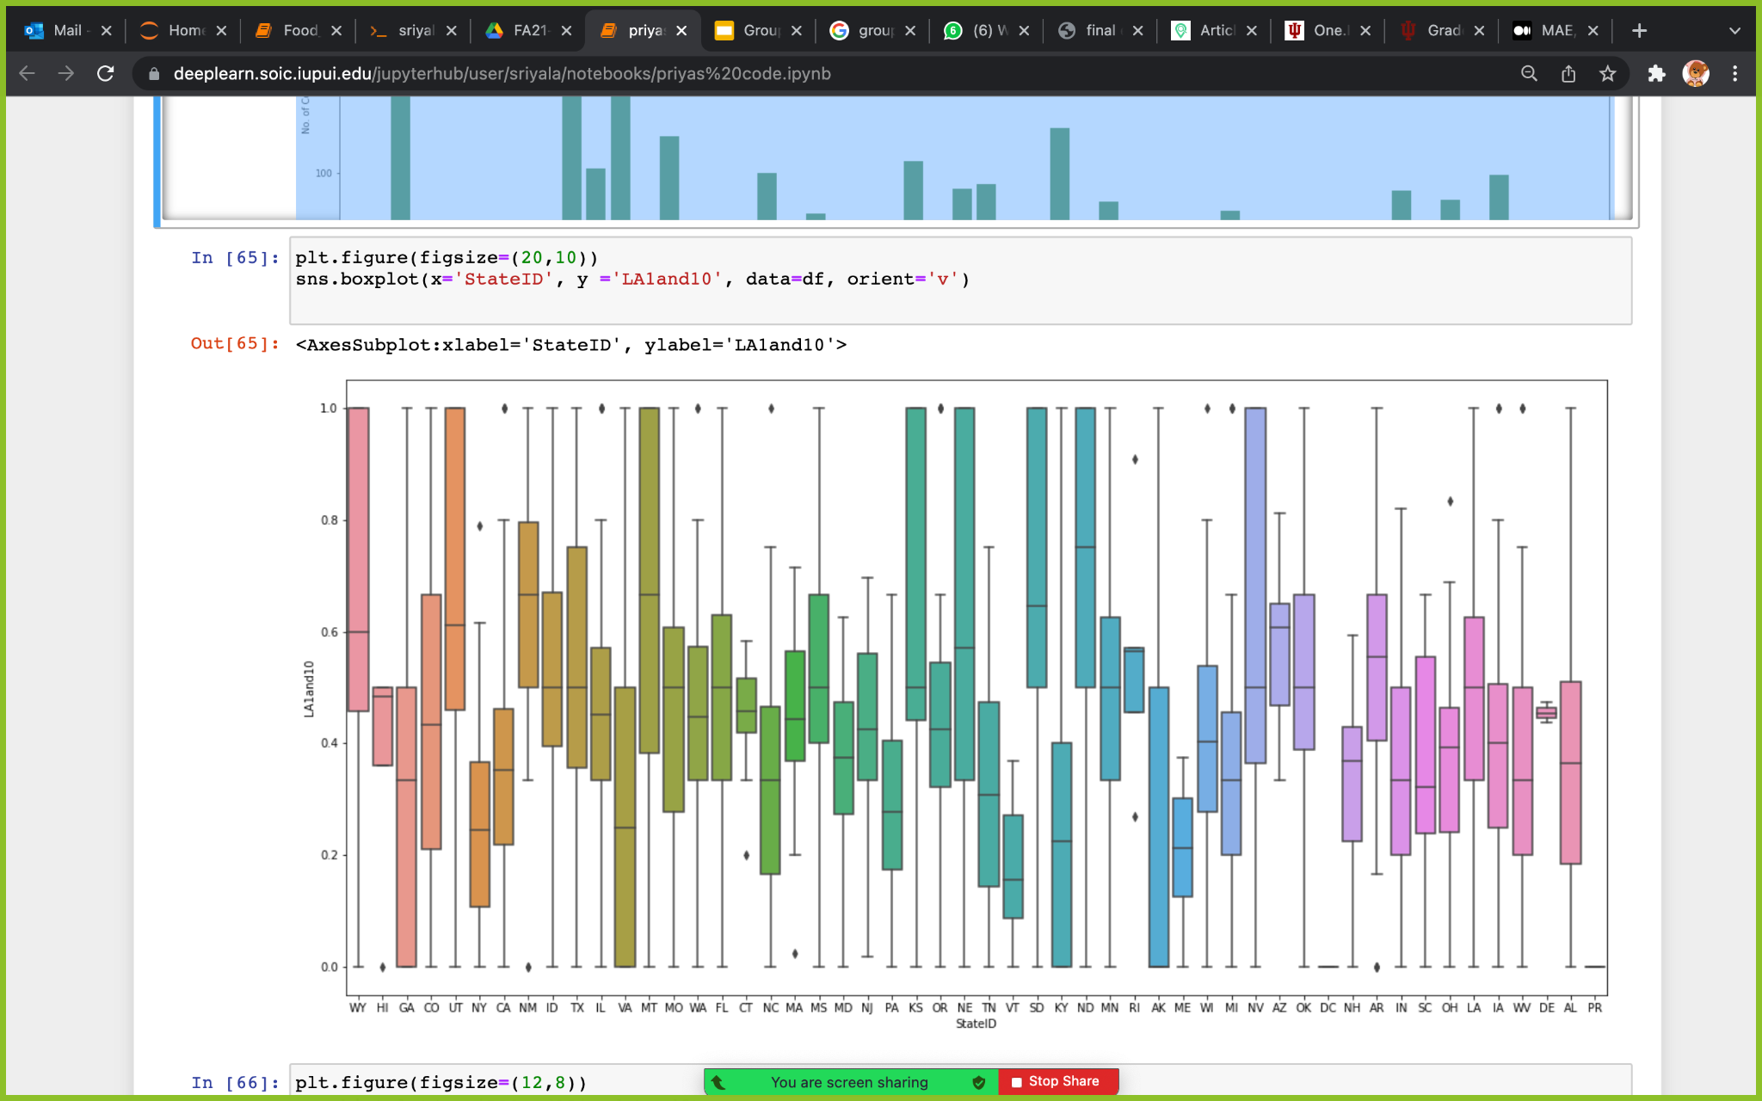
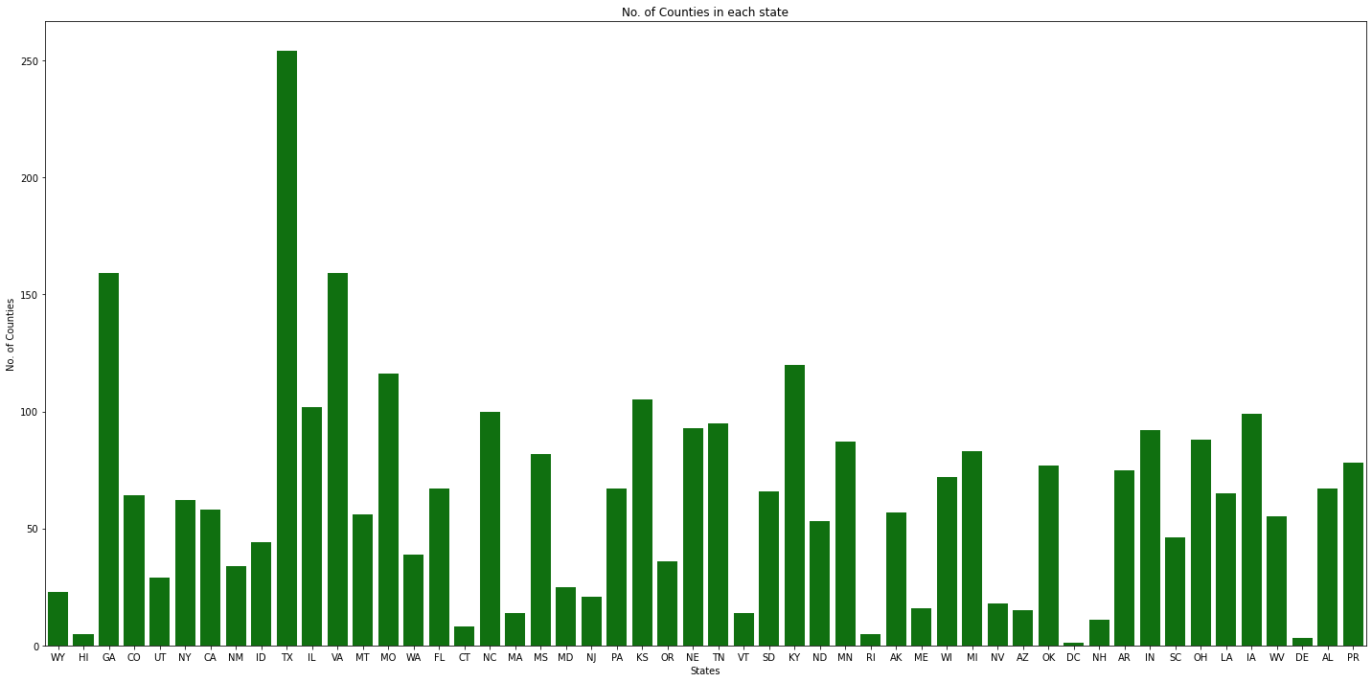
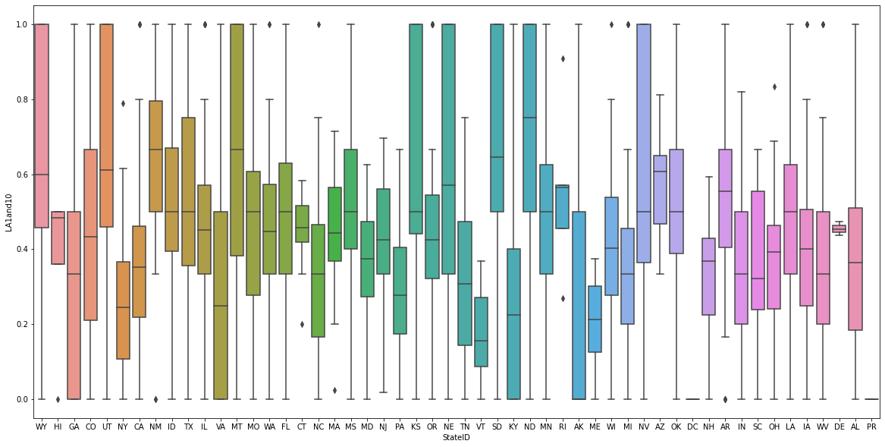
No of counties per state - Bar Chart
LA1and10 with State-Box Plot

Slide 17
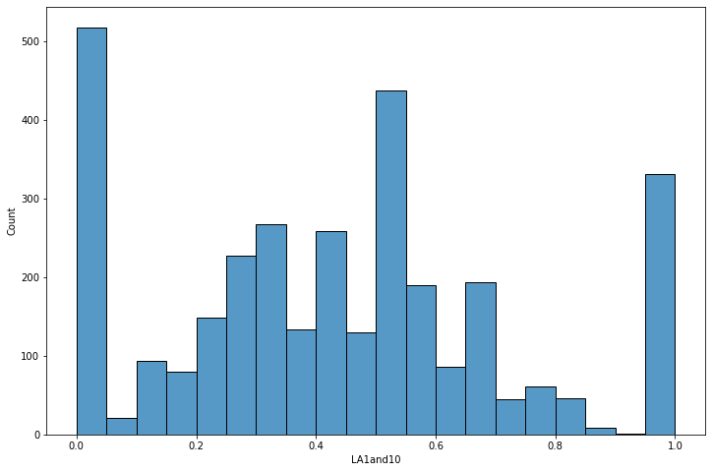
Histogram of target variable (LA1and10)

Slide 18
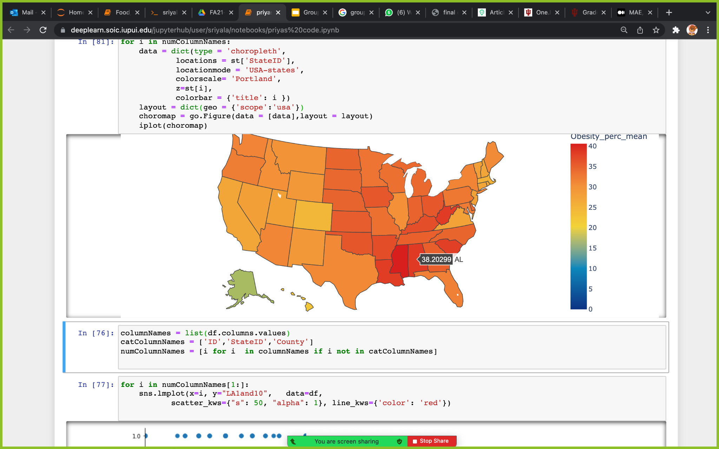
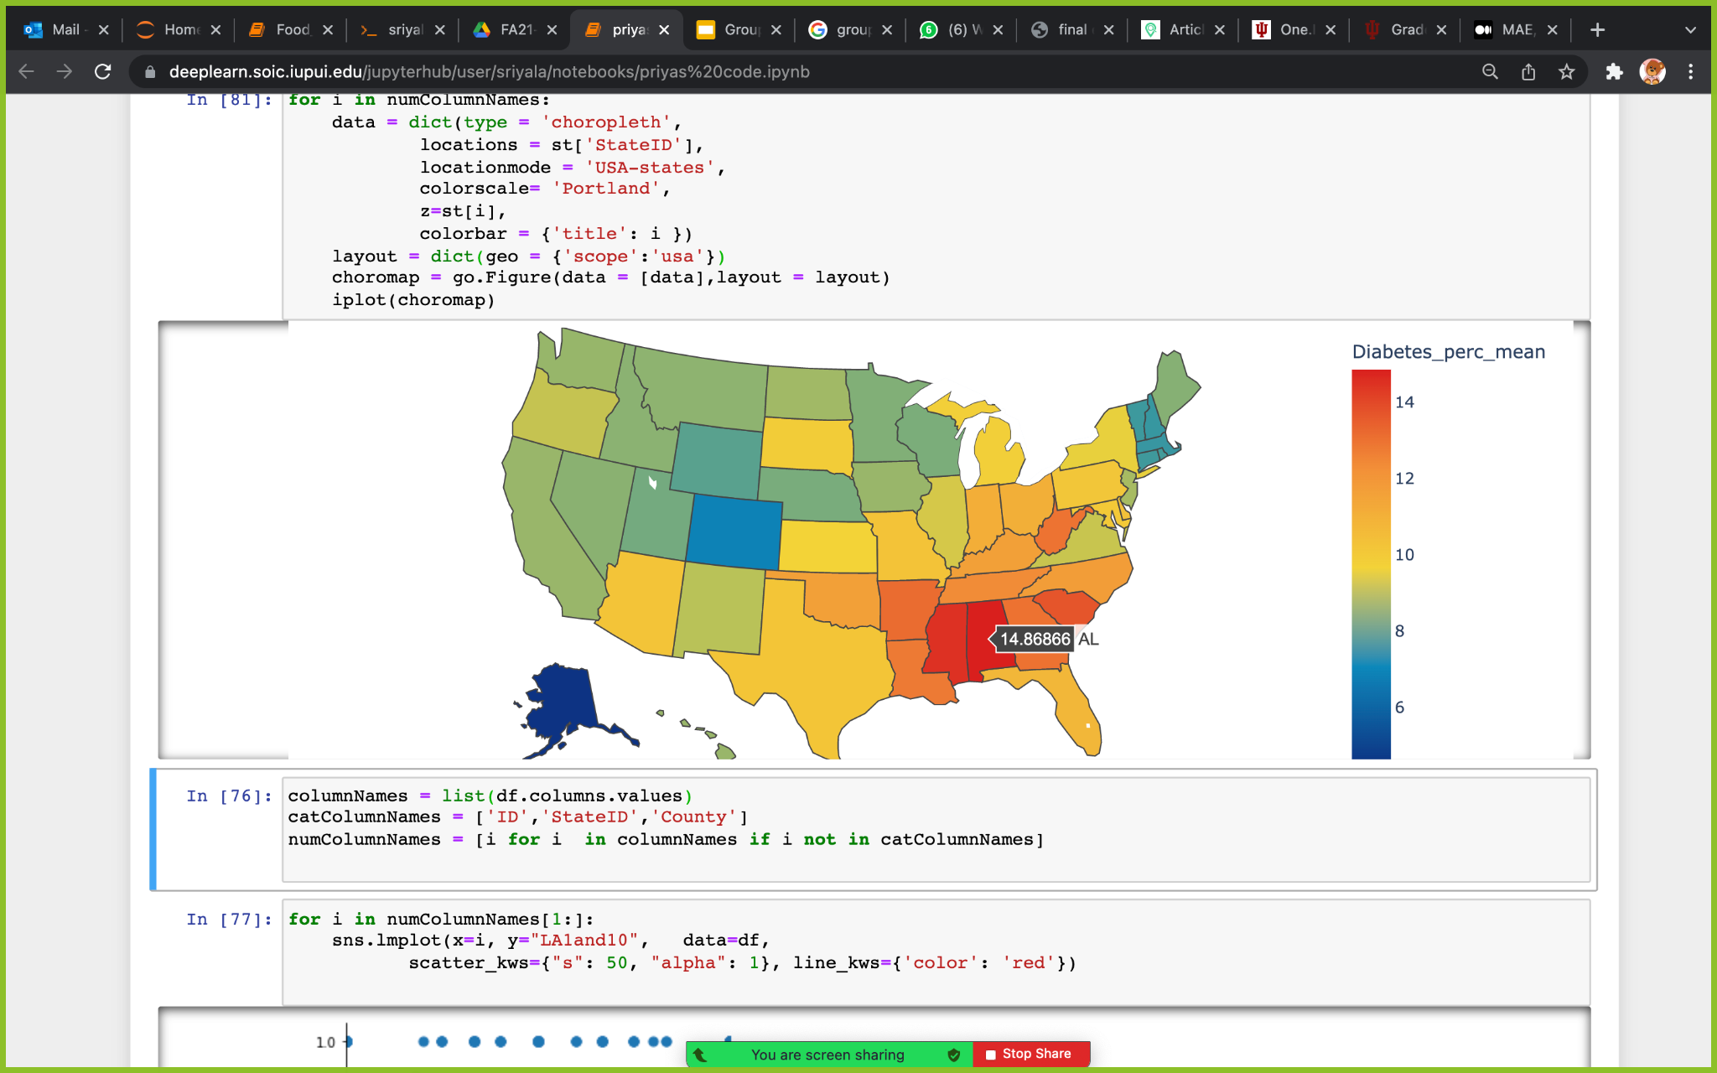
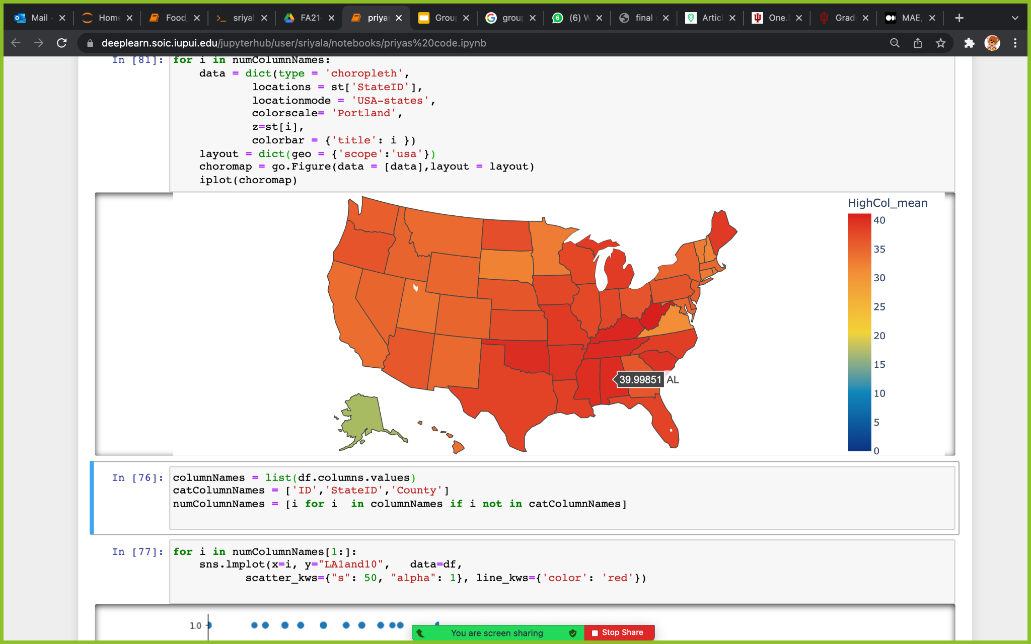
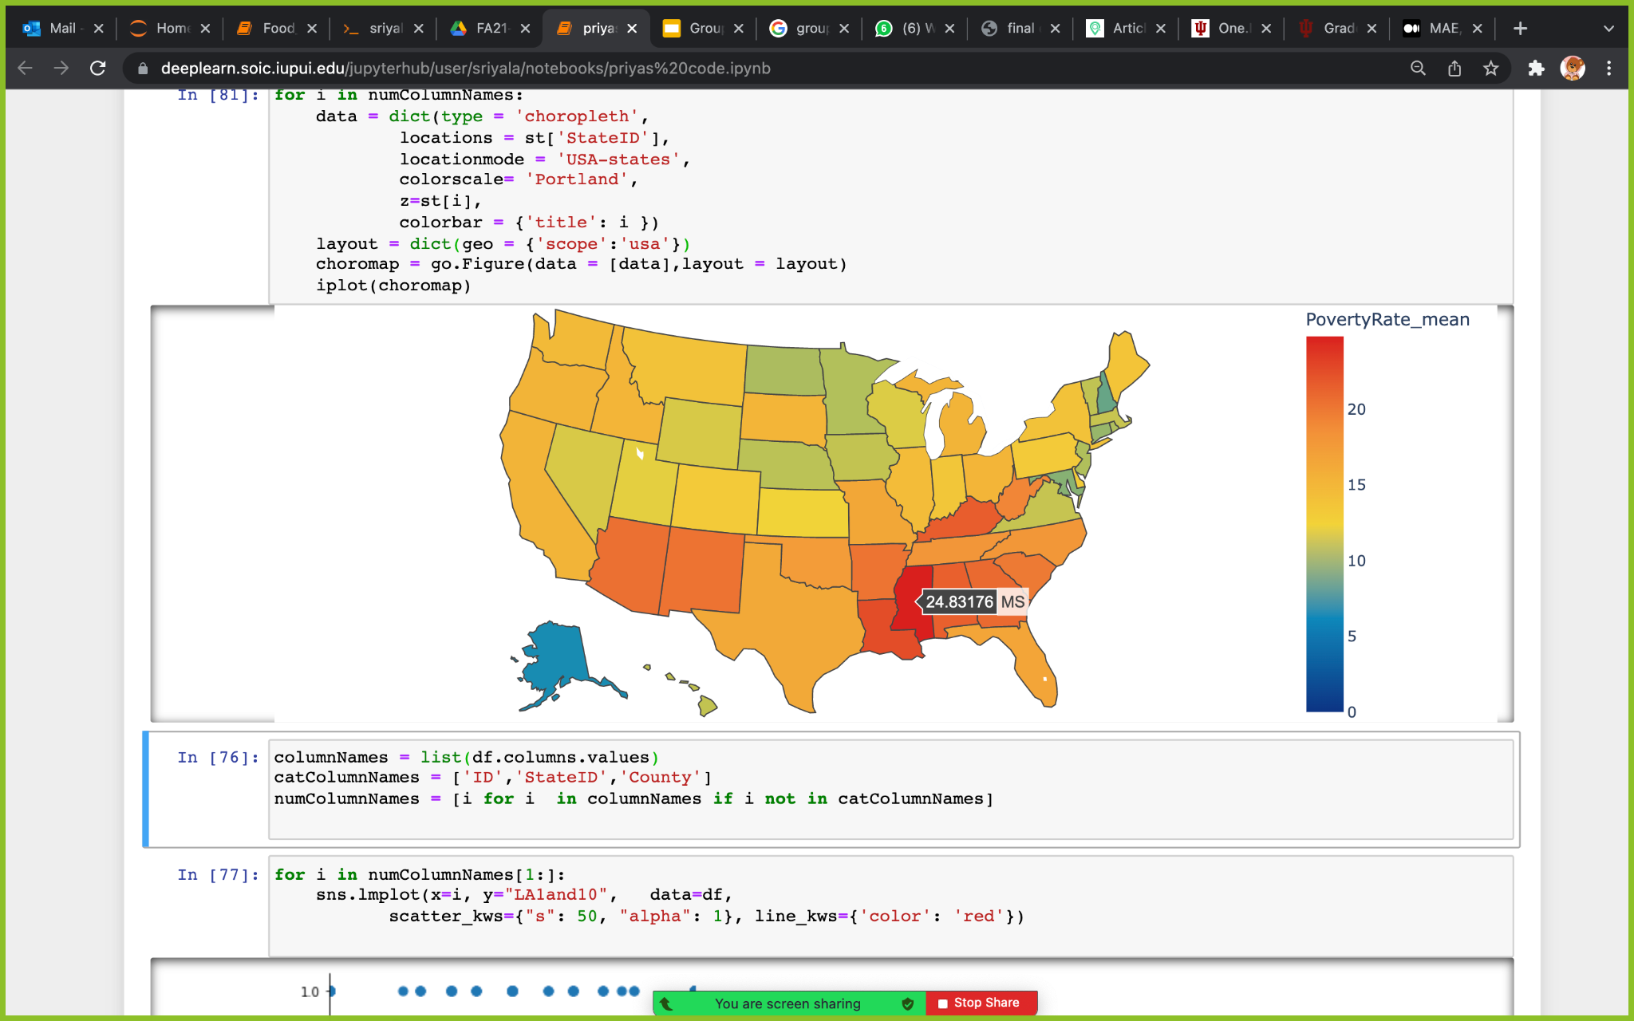
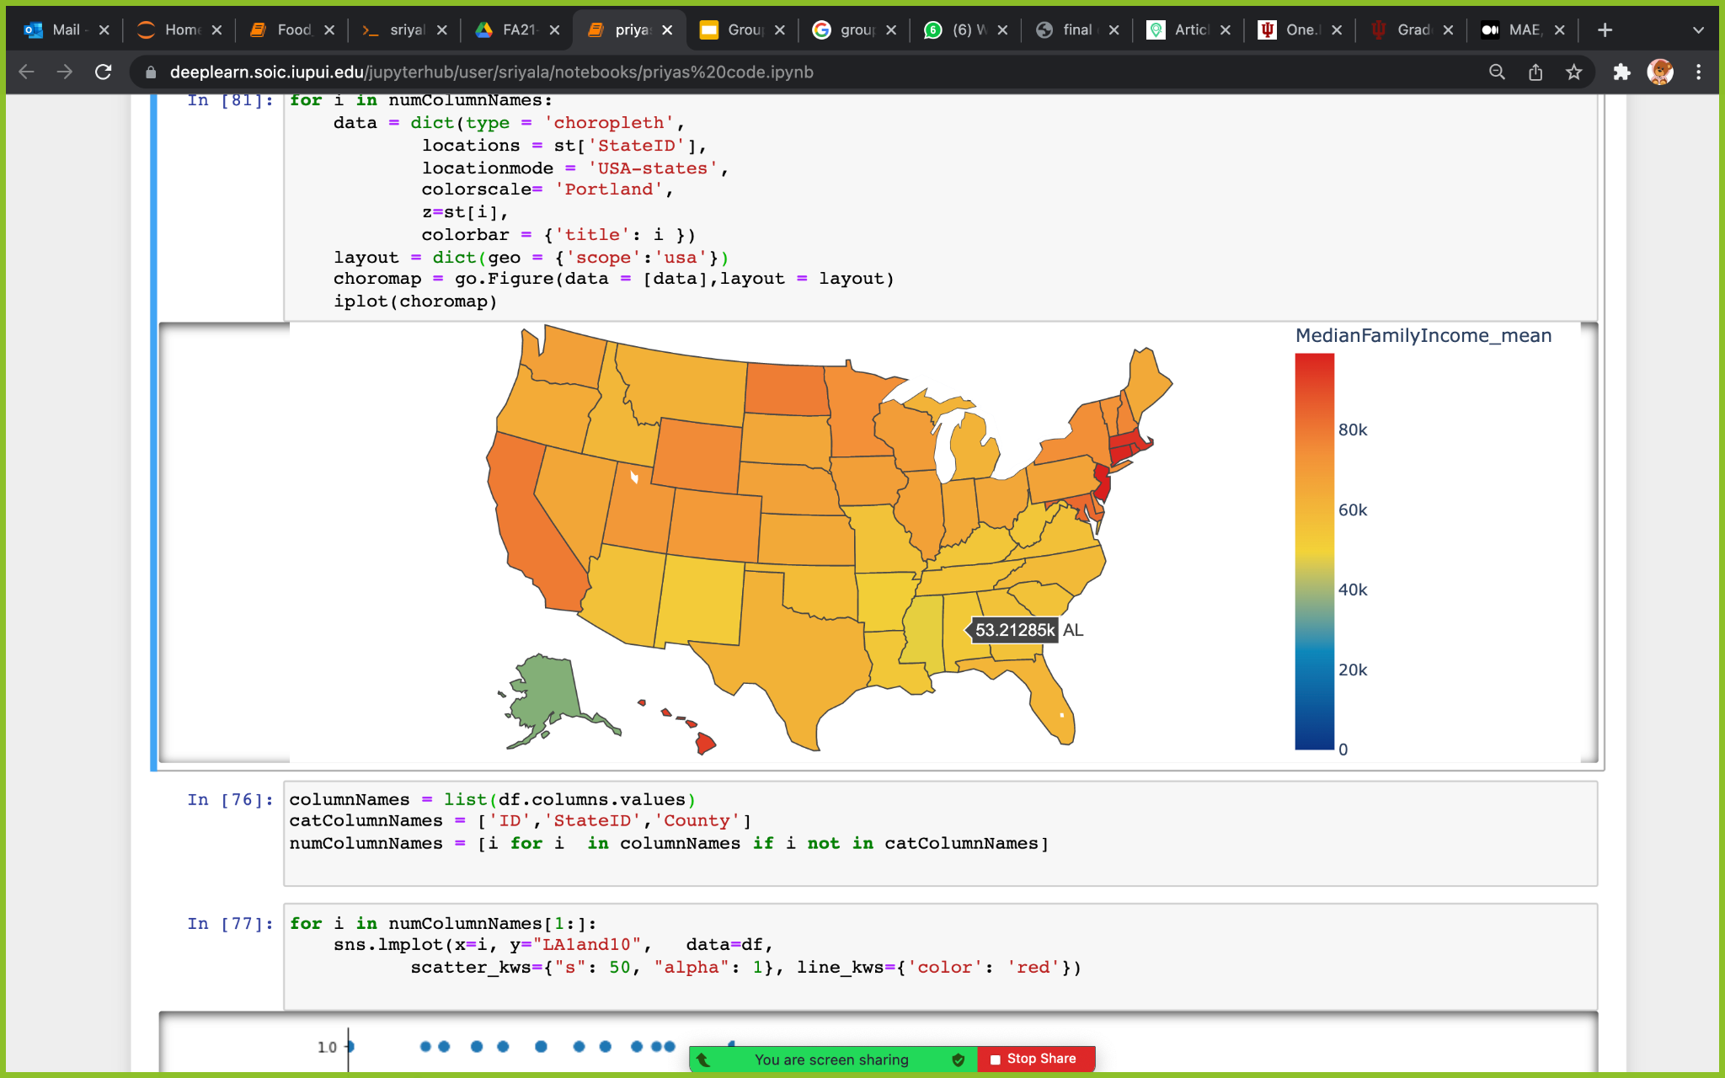
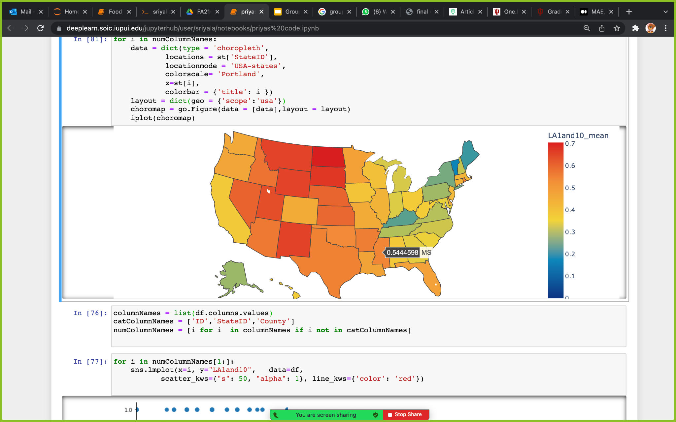
Choropleth Maps

Slide 19
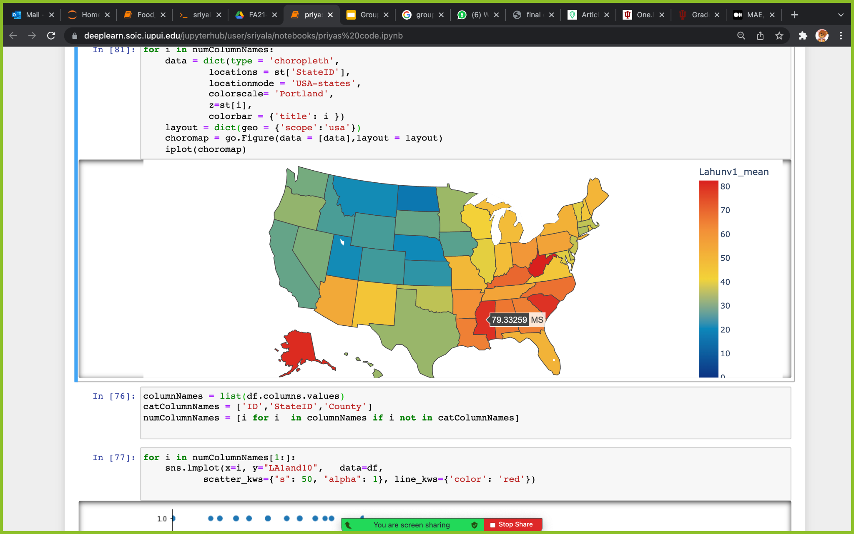
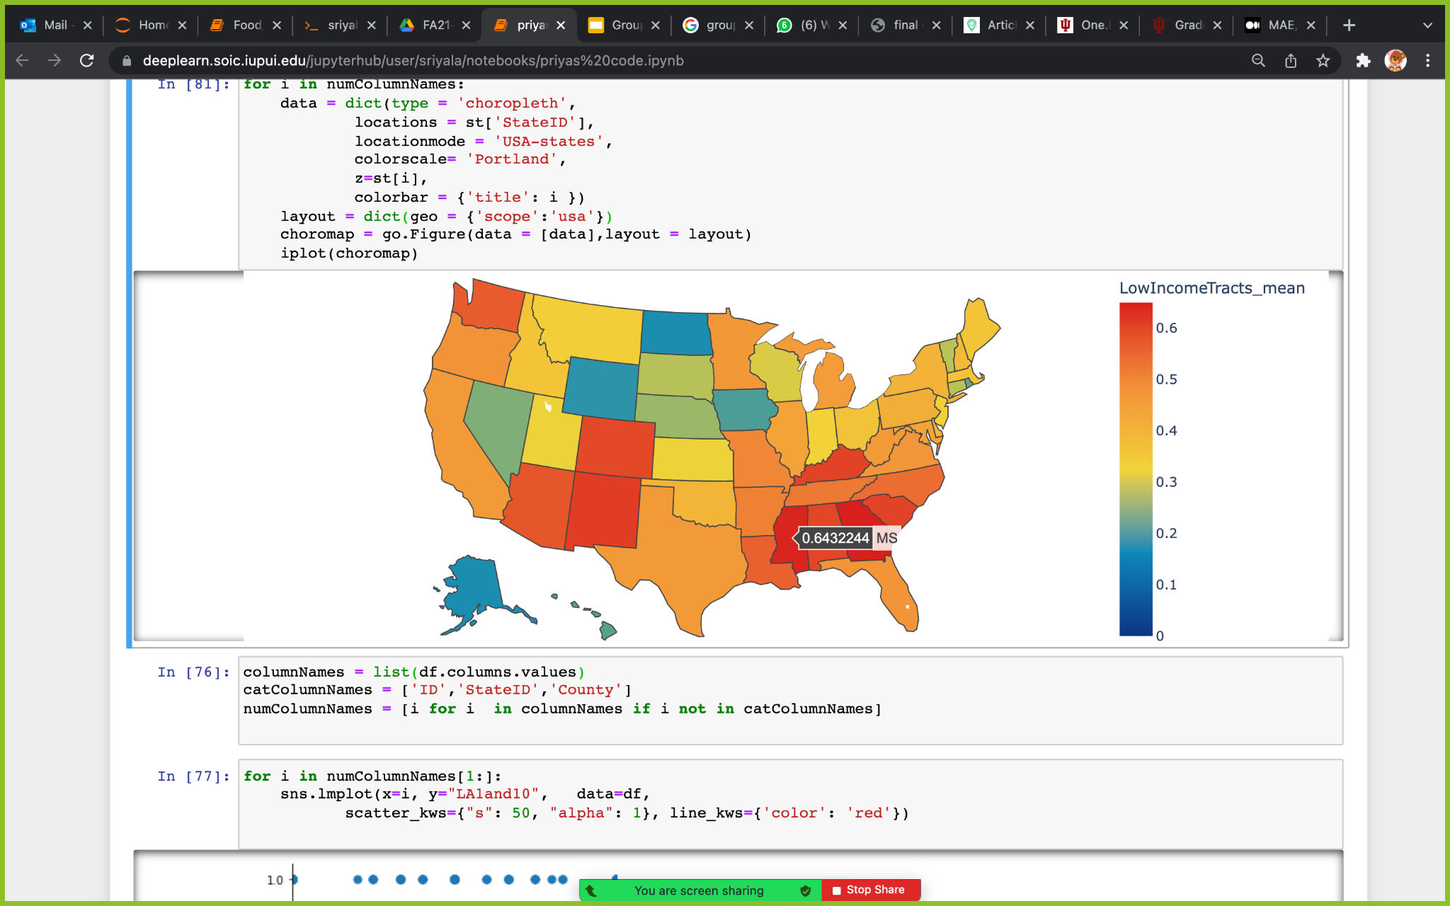
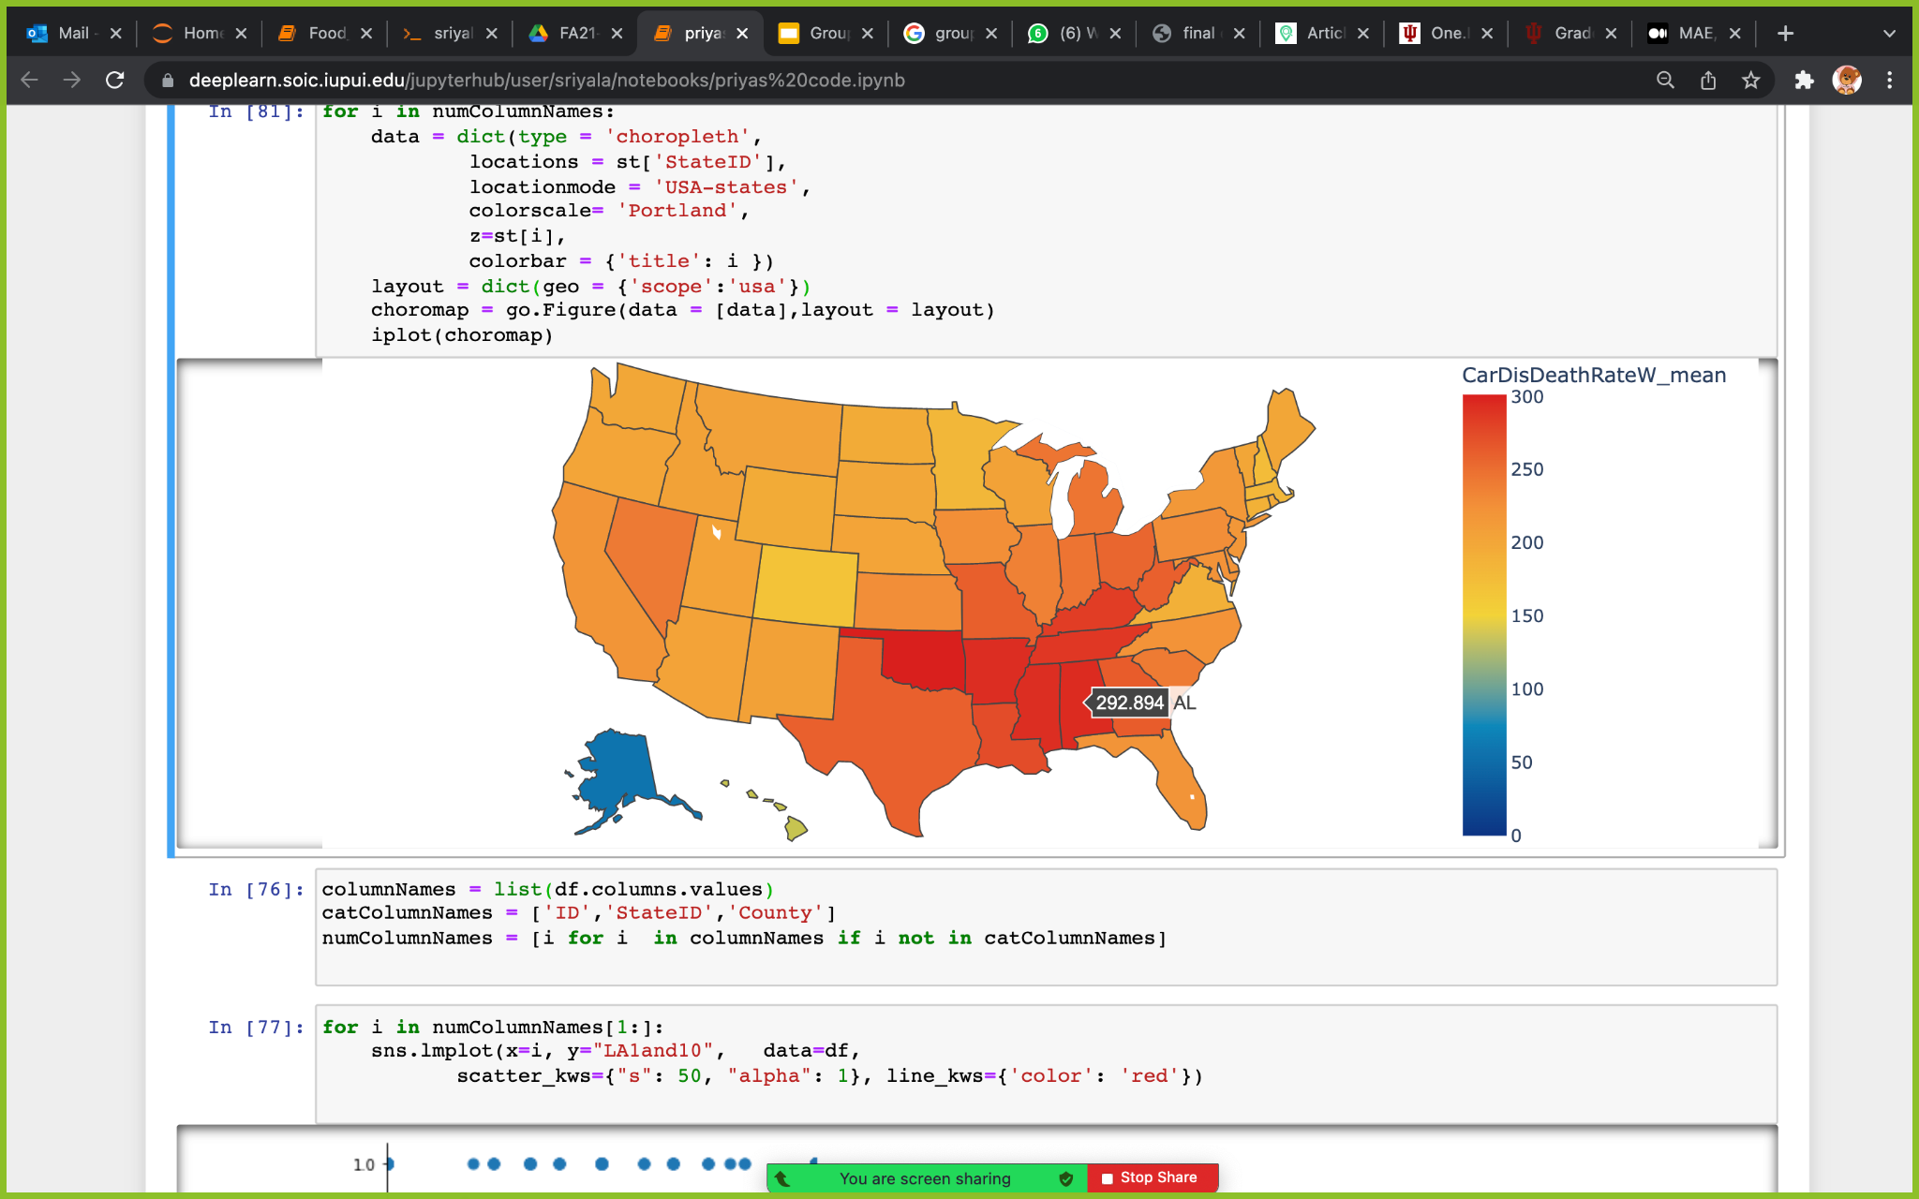
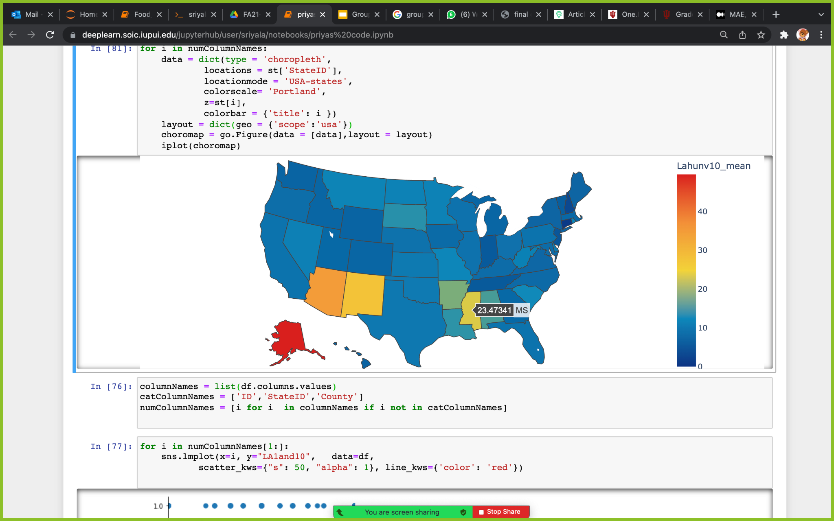
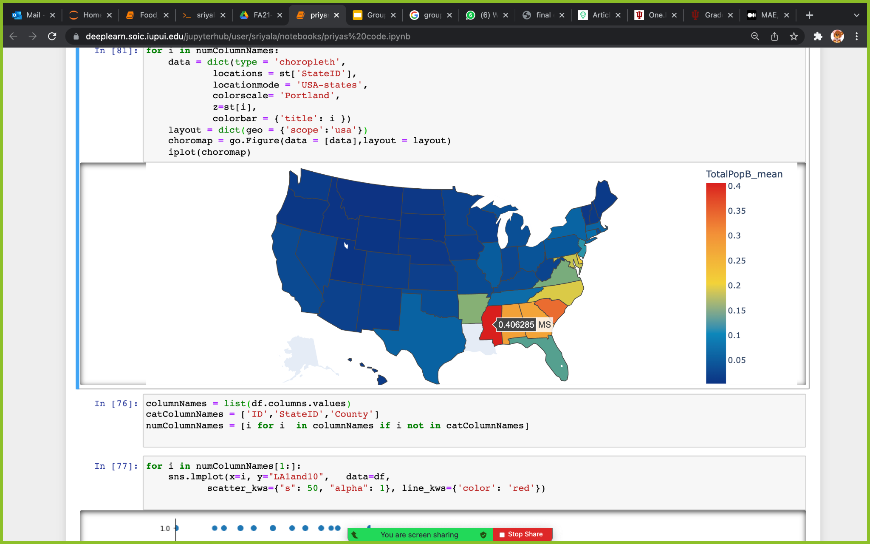
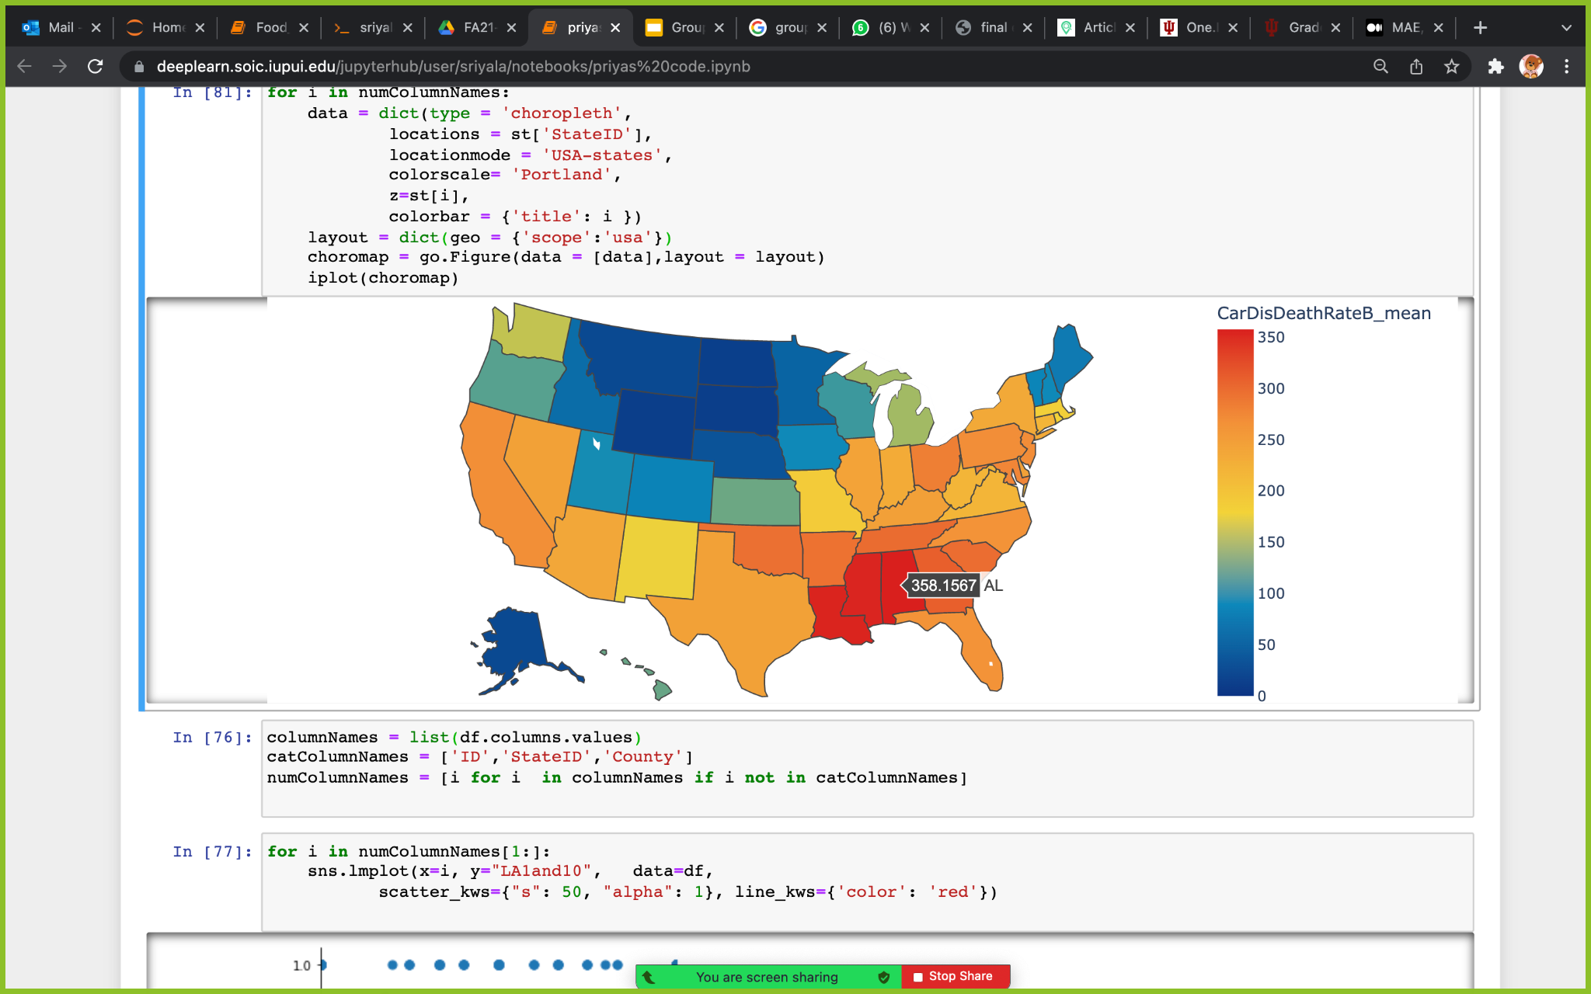

Slide 20
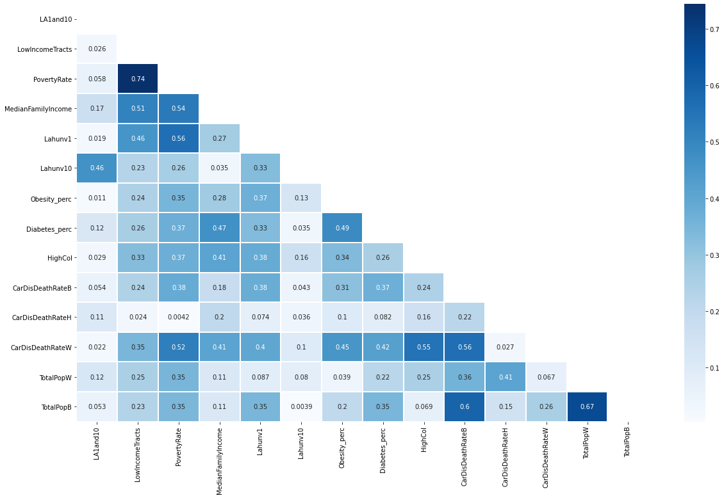
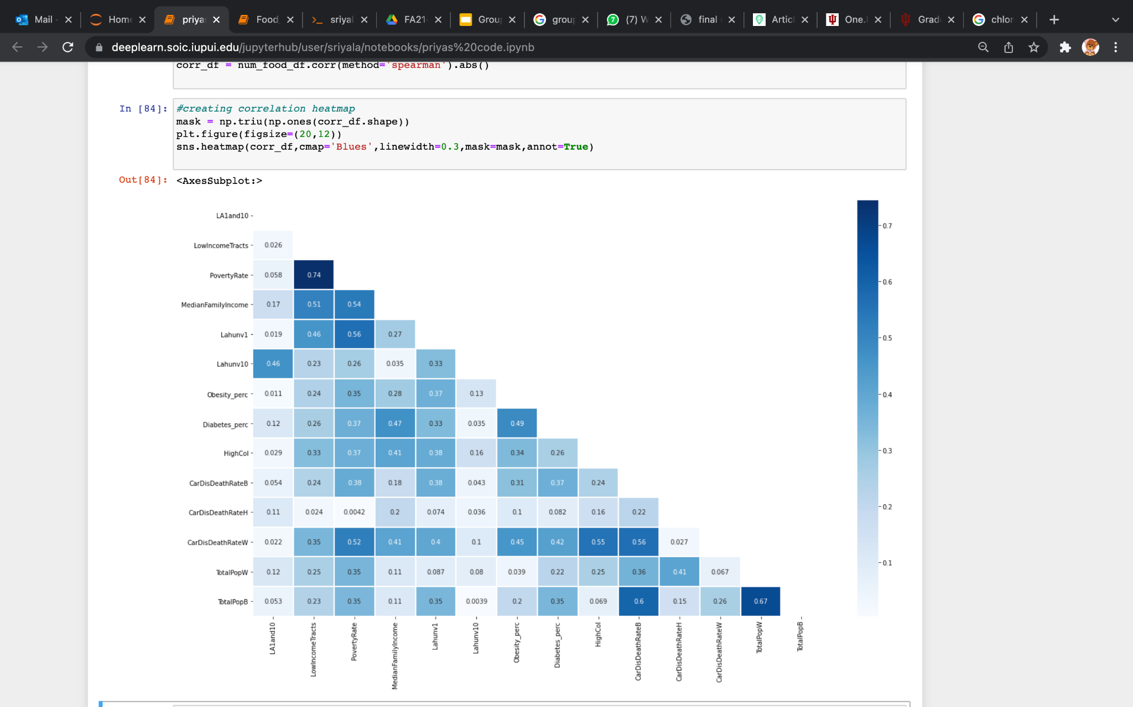
Correlation Heatmap

Slide 21
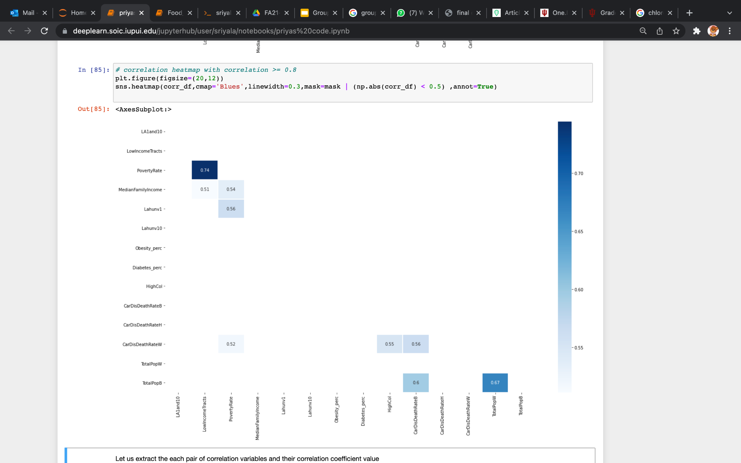
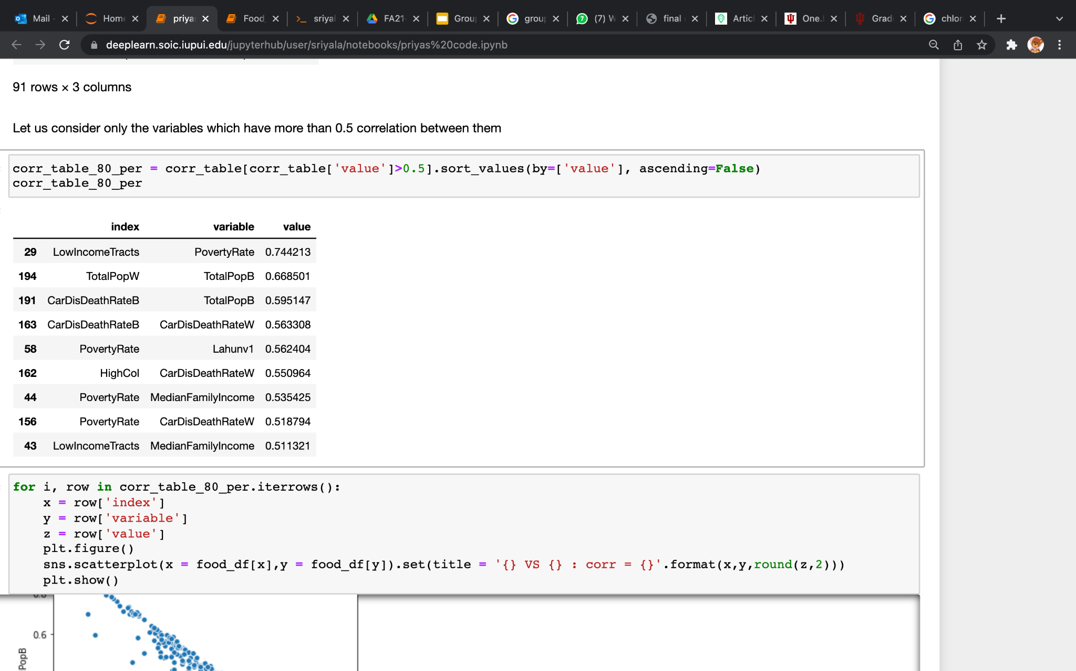
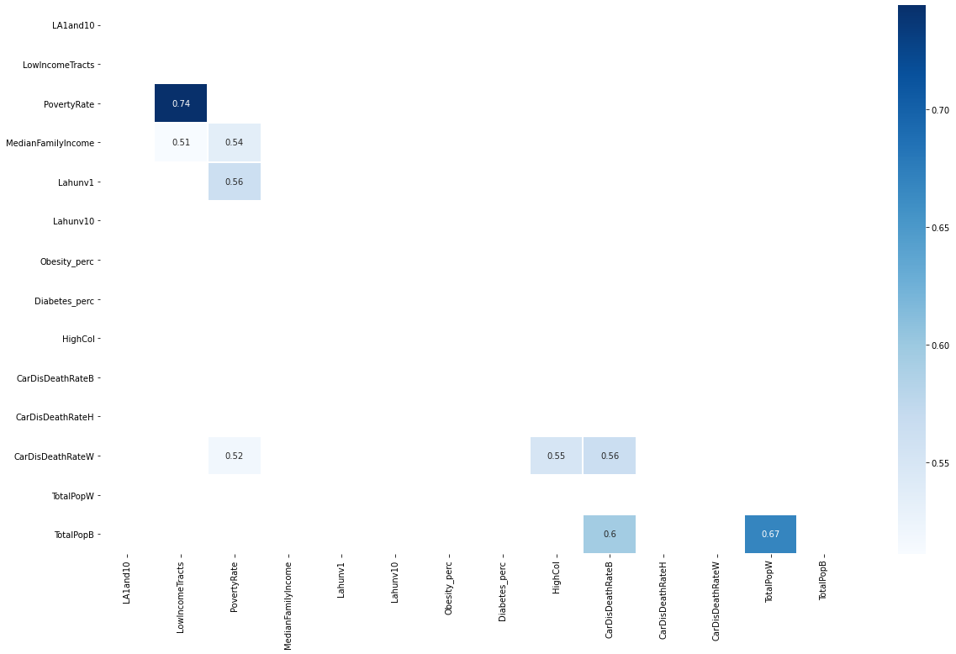
-Variables which have >0.5 correlation between them

Slide 22
Exploratory Data Analysis

Slide 23
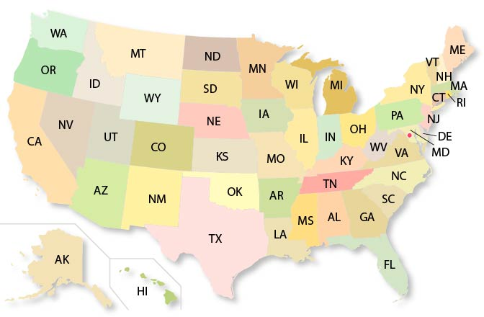
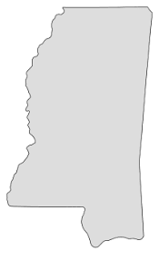


Macro vs. Micro
MS
AL

Slide 24
Why Alabama (AL) and Mississippi (MS)?
Health Data Rankings
Alabama:
#1 in diagnosed diabetes
#2 in obesity
#4 in high cholesterol
Socio-Economic Data Rankings
Mississippi
#1 in poverty rate
#2 in low-income
#2 in median family income
#9 in population only having high-school graduate

Slide 25
Alabama Normality Tests
Performed Shapiro-Wilk Test on the dependent and independent variables (cutoff P-value of 0.05)
Gaussian
LA1and10
LowIncomeTracts
CarDisDeathRateB
Non-Gaussian
Obesity_perc
Diabetes_perc
HighCol
PovertyRate
MedianFamilyIncome
S1501_C01_009E
S1501_C01_010E
PopB_perc
PopW_perc
CarDisDeathRateW
Lahunv1

Slide 26
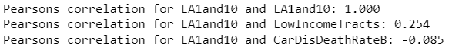
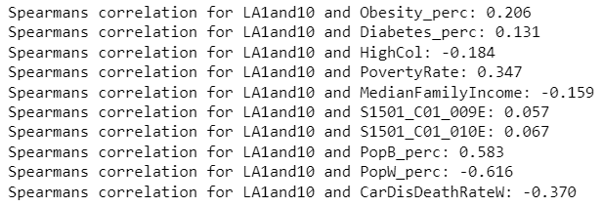
Alabama Correlation Tests
Performed Pearson’s Correlation Test for data samples w/ Gaussian distribution:
Performed Spearman’s Correlation Test for data samples w/ non-Gaussian distribution:

Slide 27
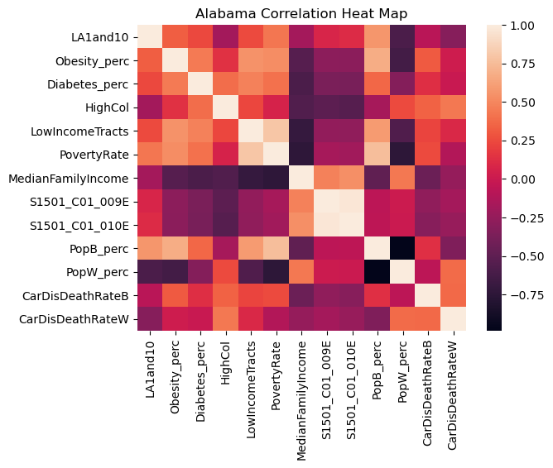
Alabama Correlations
Top correlations:
Population % of African-Americans
Poverty Rate
Obesity

Slide 28
Alabama Statistical Test #1
Research Question: Are food deserts more prevalent in counties that have higher populations of minorities?
Test Type: Unpaired T-Test (sample = 30)
Test Result: The amount of food deserts in primarily Caucasian counties is significantly different from the amount of food deserts in primarily African-American counties.
(P = 0.000, < 0.05 so null hypothesis is rejected)

Slide 29
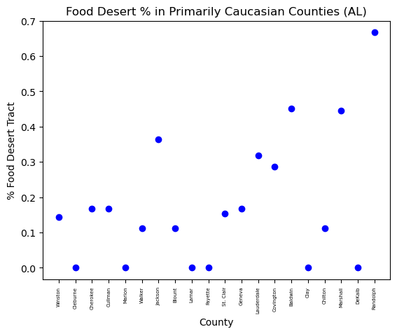
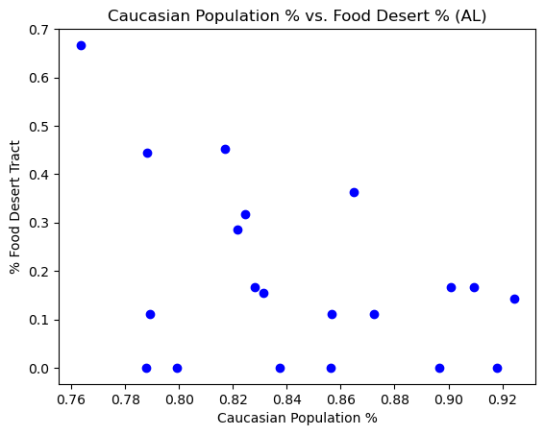
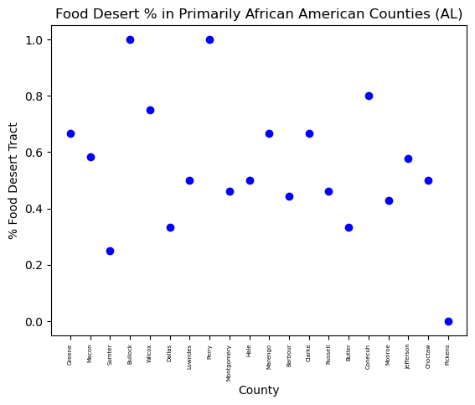
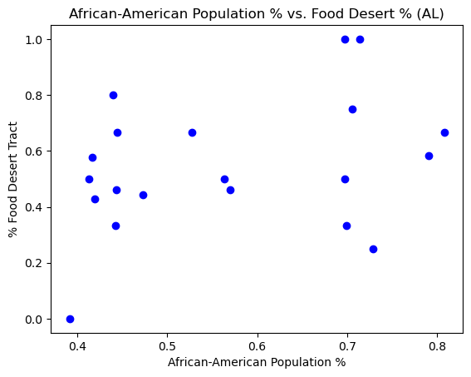

Slide 30
Alabama Statistical Test #2
Research Question: Do food deserts result in higher percentages of people living with diabetes and cardiovascular diseases?
Test Type: Unpaired T-Test (sample = 30)
Test Result: The amount of food deserts in counties with high percentages of high-cholesterol and diagnosed diabetes are similar to the amount in counties with low percentages of high-cholesterol and diagnosed diabetes.
(P_{Diabetes} = 0.110, P_{High-Cholesterol} = 0.409 > 0.05 so null hypothesis is accepted)

Slide 31
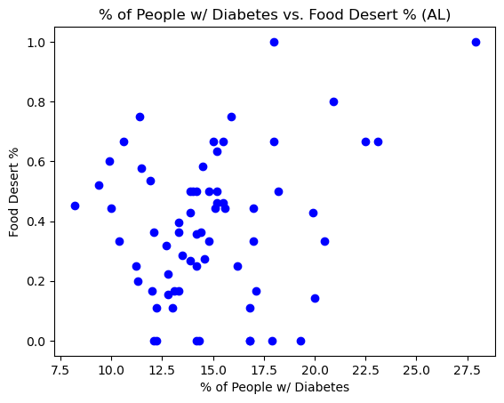
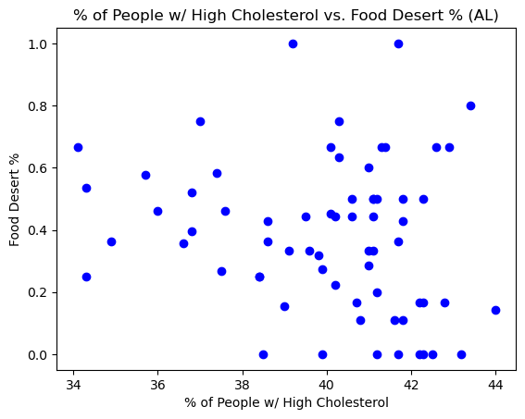
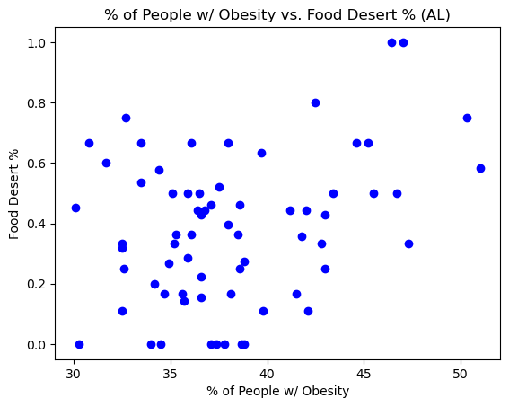

Slide 32
Alabama Statistical Test #3
Research Question: Does lacking a vehicle and living in a food desert increase risk of becoming unhealthy?
Test Type: Mann-Whitney U test (sample = 30)
Test Result: The percentages of people living with obesity and high-cholesterol in counties that have more housing units without a vehicle is similar to the percentages of people living with obesity and high-cholesterol in counties that have less housing units without a vehicle.
(P_{Obesity} = 0.068, P_{High-Cholesterol} = 0.057 > 0.05 so null hypothesis is accepted)

Slide 33
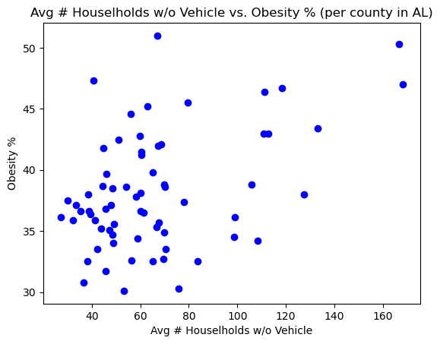
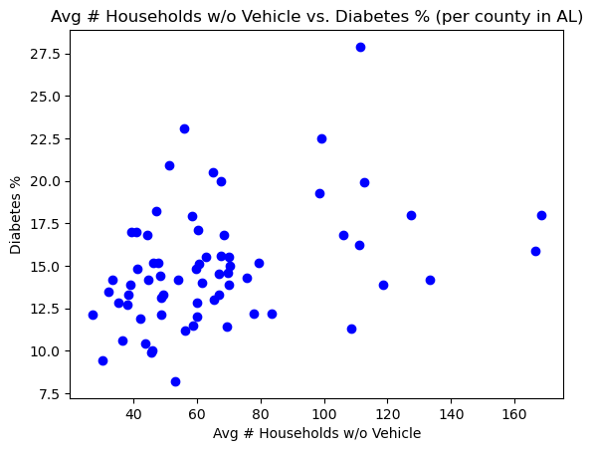
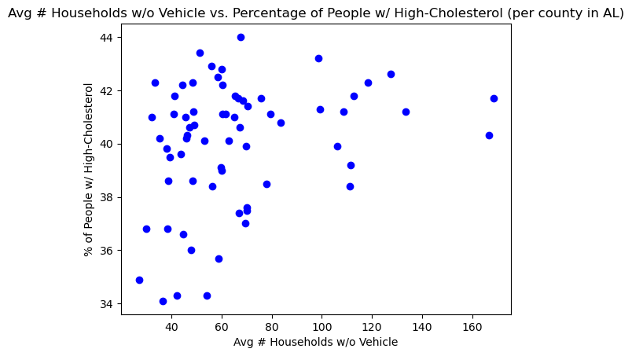

Slide 34
Alabama Statistical Test #4
Research Question: Do people that live in low-income and high poverty rate communities have a greater chance of living in a food desert?
Test Type: Unpaired T-Test (sample = 30)
Test Result: The amount of food deserts in counties with low poverty rates is significantly different than the amount of food deserts in counties with high poverty rates.
(P = 0.005 < 0.05 so null hypothesis is rejected)

Slide 35
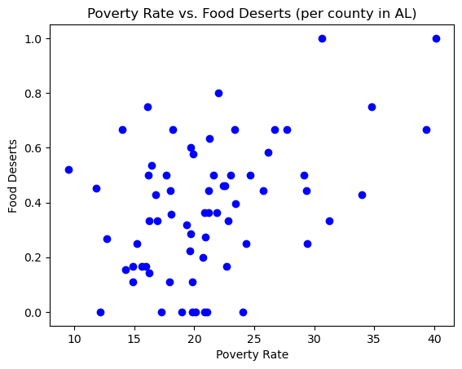
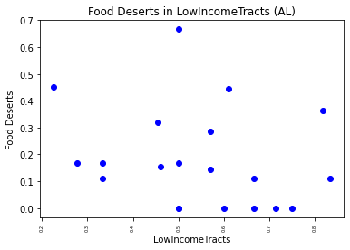

Slide 36
Alabama vs. Mississippi
Null Hypothesis | Alabama | Mississippi
Food deserts are not more prevalent in higher populations of minorities. | H₀ rejected | H₀ accepted
Food deserts do not contribute to increased percentages of diabetes, high-cholesterol, obesity or cardiovascular diseases. | H₀ accepted | H₀ accepted
Not having a vehicle and living in a food desert does not increase risk of becoming unhealthy. | H₀ accepted | H₀ rejected
People that live in low-income communities do not have a greater chance of living in a food desert. | H₀ rejected | H₀ accepted

Slide 37
Predictive Modeling
Notes:
Evaluation of models using metrics, feature importance (best features to use within model), cross validation

Slide 38
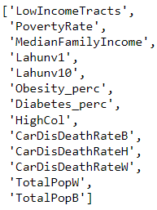
GOAL
Create ML Models for predicting the proportion of food deserts in a county
Types of models created:
Model for counties in all states
Model for counties in low-performing states (AL, MS, WV)
Model for counties in high-performing states (GA, CA, IN)
Independent Variables:
Target Variable :
LA1and10

Slide 39
Machine Learning Models used
Evaluation Metrics measured
Linear Regression
K Nearest Neighbors Regressor
Decision Tree Regressor
Random Forest Regressor
Stochastic Gradient Descent Regressor
Gradient Boosting Regressor
Mean Absolute Error (MAE)
Mean Squared Error (MSE)
Root Mean Squared Error (RMSE)
R2 Score

Slide 40
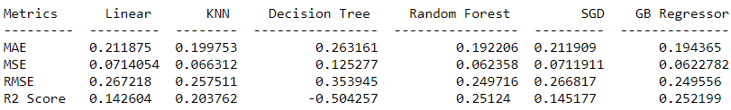
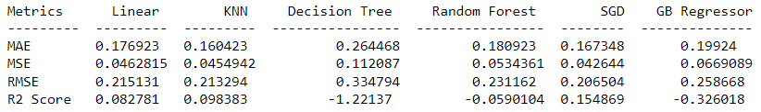
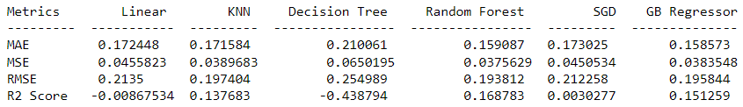
Model for counties in all states
Model for counties in low-performing states
Model for counties in high-performing states

Slide 41
Best model for each type and its R2 score
Model for counties in all states - GB Regressor - 0.25
Model for counties in low-performing states - SGD - 0.15
Model for counties in high-performing states - RF - 0.16

Slide 42
Conclusions
Notes:
Summarize overall observations…accepted null hypothesis or not

Slide 43
Conclusions:
ALABAMA RESULTS:
Food deserts are influenced by minority populations and socioeconomic factors
Food deserts does not influence health condition
Transportation facilities in food deserts does not influence health conditions.

Slide 44
THANK YOU.

Slide 46
Appendix
Notes:
Summarize overall observations…accepted null hypothesis or not

Slide 47
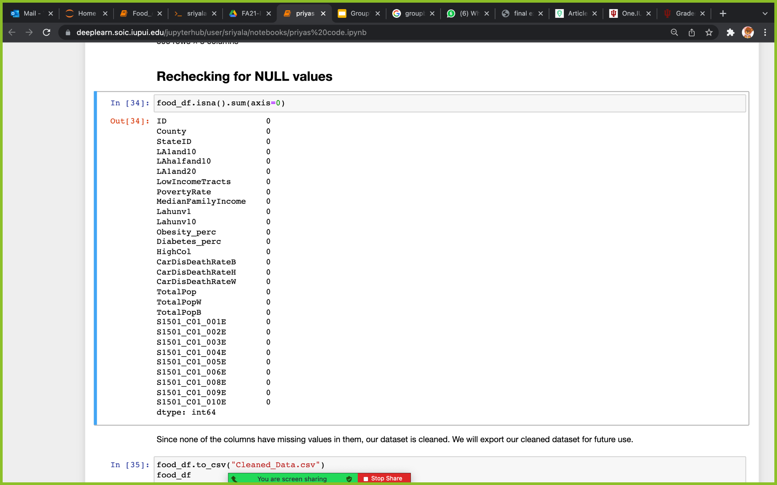

Slide 48






CODE

Slide 49


PAIRPLOT:

Slide 50










SCATTER PLOT: for variables which have more than 0.5 correlation between them

Slide 51


Using high-performing state counties’ model on low performing state counties
Using low-performing state counties’ model on high performing state counties

Slide 52



OUTLIERS:
After removing outliers, most of the rows that will have accurate data got deleted. Also, much correlation was found between target and other variables

Slide 53




Slide 54


